Slide 1
What are source in dbt?
In dbt, sources are the raw tables in your data warehouse.
Think of them as the starting point of your data pipeline.
They tell dbt: 👉 “This table already exists in the warehouse, and we will use it to build our transformations.”
✨ Why Use Sources?
Clear separation – You know what is raw data vs what dbt created.
Documentation – Sources let you describe where raw data comes from.
Testing – You can add tests (like “no nulls in id column”) directly on raw tables.
Traceability – You can track the full data journey: raw → transformed → final models.

Slide 2
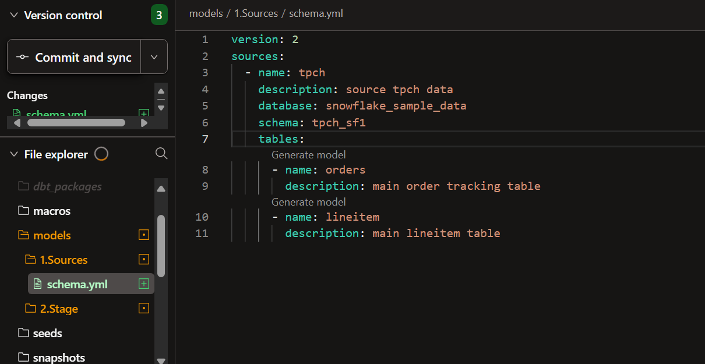
🛠 How to Define a Source?
You define sources inside a schema.yml file
🔹 sources: → Tells dbt these are raw tables
🔹 name: → A name you’ll use to reference this group of tables
🔹 tables: → List of the actual raw tables
.

Slide 3
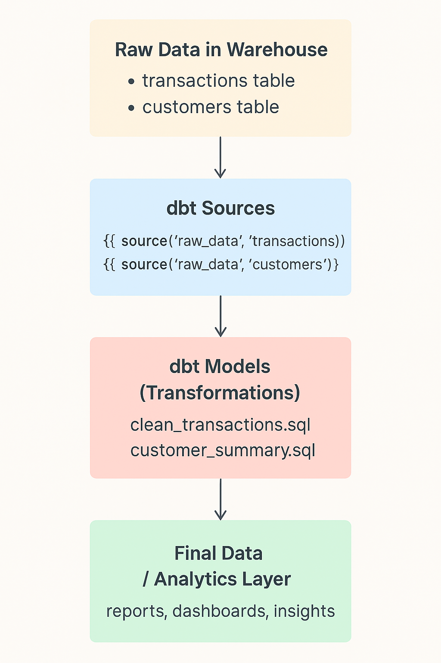
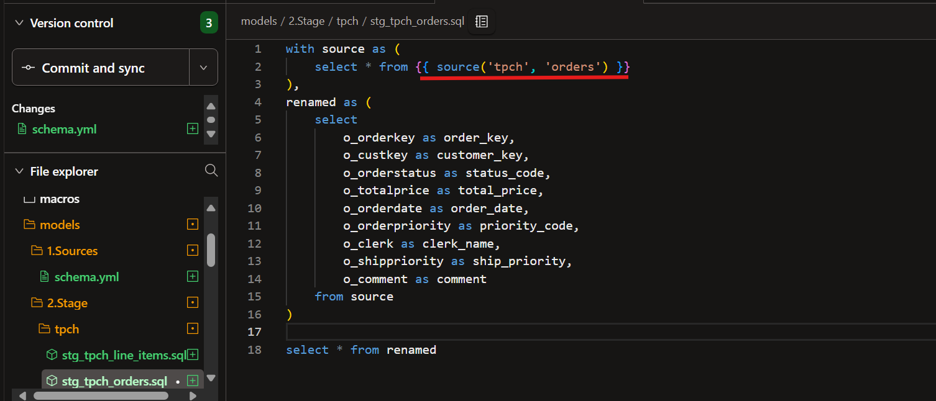
📌 How to Use a Source in Models?
You don’t write the table name directly. Instead, you use the source() function.
dbt understands that orders is a source table under the tpch source.
At compile time, dbt converts it into the fully qualified name: snowflake_sample_data.tpch_sf1.orders

Slide 4



🎯 Real-World Benefits
Lineage
Collaboration
Data Quality
See exactly where
data came from
Team members understand
raw data sources
Add tests at the source level so data issues are detected early and don’t spread downstream.

Slide 5

Demonstration
Streamlines the data transformation process, reducing manual intervention and potential errors.

